Slide 1

Format-Preserving Compression-Tolerating
Authenticated Encryption for Images
Alexandra Boldyreva Kaishuo Cheng Jehad Hussein

Slide 2





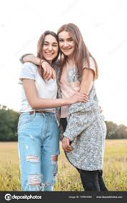
Motivation
Notes:
Suppose you take a photo of you and your friend, and wants to upload to image centering apps that only takes images like google photo for storage.

Slide 3

Motivation
Compression
Notes:
When the server stores the file, it will not store the exact file, but a compressed version of it to save storage space. It will compress regardless of how your image was compressed before. Add that compression is lossy.

Slide 4
Motivation
Compression
Notes:
The vague image is an exaggeration. In reality, the compression has little to no effect on visual quality.

Slide 5

Motivation – Privacy
k
Encrypt
Compression
k
Decrypt
k
Notes:
Now, you might fear that if you store image in plaintext, the server will share the image without your conset, or server is compromised. Indeed, more and more messaging apps now implement end-to-end encryption mitigate these risks. Here, A natural approach is to encrypt..We can convert images to bits and encrypt, but

Slide 6


Motivation
Standard Encryption scheme
will not work!
k
Encrypt
Compression
k
$$≠$$
Decrypt
k
Notes:
But decryption will fails immediately, as the ciphertext is compressed.

Slide 7
Prior Work
Enormous existing work in signal processing community include permuting image pixels and chaotic-mapped based approaches.
Unfortunately, none of these work have formal security analyses. Schemes that permute pixels are shown to be vulnerable against “JigSaw Attack”, which can recover part of the original image from the ciphertext image.
Koh et. al proved the permutation method is secure against weak brute-force attacker.
Notes:
And the idea of encrypting images before compression is not new. There has been \emph{enormous} prior work from signal processing community, like permuting and substituting image pixels. However, these work lack formal security analyses, some are even broken.

Slide 8
Our Focus
We want to have end-to-end image encryption applications where ciphertexts images are compressed by servers.
We present a new primitive called “authenticated image encryption” that is format-preserving and compression-tolerating.
We give a construction for the most widely used compression algorithm JPEG and prove that our construction is secure.

Slide 9




Authenticated Image Encryption (aIE)
$$\text{k}$$
$$\text{k}$$
/
aIE.Enc
aIE.Dec
$$⊥$$
Compr ( )
Notes:
Our new primitrive authenticated image encryption aIE has two algorithms: encryption, and decryption. Encryption takes in key k and plaintext image, outputs a ciphertext image. Decryption takes in key k, and a compressed ciphertext image, and either outputs a plaintext image or bot. message space is set of images

Slide 10
Definitions (Informally)
$$\text{k}$$
$$\text{k}$$
/
aIE.Enc
aIE.Dec
$$⊥$$
Compr ( )
Correcntess:
← aIE.Enc(k, ))
≈
≈
aIE.Dec(k,Compr ( ))
: A similarity function that we
use to approximate
visually similar
Secrecy:
ind-cpa
Notes:
For correctness, we want the decrypted image to be as close to the original plaintext imgae as possible. For secrecy, we require the sender ciphertext to ind-cpa secure. Here, we use a similarity function that we use to approximate visually similar.

Slide 11
Definitions (Informally)
$$\text{k}$$
$$\text{k}$$
/
aIE.Enc
aIE.Dec
$$⊥$$
Compr ( )
Integrity:
No adversary can forge ciphertext
≈
s.t. aIE.Dec decrypts to some image
(fuzzy int-ptxt)
Notes:
For integrity, we require that no adversary can forge a ciphertext such that decrypts a image that is dissimilar to original plaintext image. There is also a corresponding fuzzy ind cca notion that is implied by ind cpa and fuzzy int-ptxt.

Slide 12
Definitions (Informally)
$$\text{k}$$
$$\text{k}$$
/
aIE.Enc
aIE.Dec
$$⊥$$
Compr ( )
“Fuzzy” Replayable CCA:
≈
Adversary can learn decryption result if
Ciphertext indisguishability
Notes:
Finally, we have a fuzzy replayable cca security notion, which allows the adversary to learn decryption result of any ciphertext, as long as the decryption is not similar to plaintext queried to Encryption query.

Slide 13


Definitions (Informally)
$$\text{k}$$
$$\text{k}$$
/
aIE.Enc
aIE.Dec
$$⊥$$
Compr ( )
We proved
fuzzy
int-ptxt
fuzzy
RCCA
ind-cpa
Notes:
And fuzzy replayable cca security is implied by ind cpa and fuzzy int ptxt. Separate slide composition result

Slide 14
Our Work
We present a new primitive called “authenticated image encryption” about end-to-end image encryption that is format-preserving and compression-tolerating.
We give a construction for the most widely used compression algorithm JPEG and prove that our construction is secure.
Notes:
Now let’s see our construction.

Slide 15
Building Blocks for aIE
Image Encryption
(IE)
Image MAC
(IMAC)
aIE
Embedding
Notes:
Our aIE has three building blocks, image encryption (IE), image MAC (IMAC), and embedding.

Slide 16
Building Blocks for aIE
Image Encryption
(IE)
Transfer short strings
losslessly as part of image
Image MAC
(IMAC)
aIE
Embedding
Notes:
Embedding is spepcifically for transmitting few bits loselessly and does not involve cryptography.

Slide 17


Building Blocks for aIE
← IE.Enc($\text{k}$, )
Correcntess and Secrecy
Image Encryption
(IE)
← IE.Dec($\text{k}$, Compr( ))
Image MAC
(IMAC)
aIE
Embedding
Notes:
IE has the exact same syntax as aIE, except it does not have an integrity security notion.

Slide 18



Building Blocks for aIE
← IE.Enc($\text{k}$, )
Correcntess and Secrecy
Image Encryption
(IE)
← IE.Enc($\text{k}$, Compr( ))
tag ← IMAC.Sign($\text{k}$, )
Correcntess and Unforgeability
Image MAC
(IMAC)
aIE
0/1 ← IMAC.Verify($\text{k}$, , tag )
Embedding
Notes:
IMAC functions almost like a normal mac, except correctness requires tag verified successfully on compressed images.

Slide 19
Building Blocks for aIE
← IE.Enc($\text{k}$, )
Correcntess and Secrecy
Image Encryption
(IE)
← IE.Enc($\text{k}$, Compr( ))
tag ← IMAC.Sign($\text{k}$, )
Correcntess and Unforgeability
Image MAC
(IMAC)
aIE
0/1 ← IMAC.Verify($\text{k}$, , tag )
Use another symmetric encryption scheme SE to encrypt tag
Embedding
Notes:
IMAC functions almost like a normal mac, except correctness requires tag verified successfully on compressed images.

Slide 20
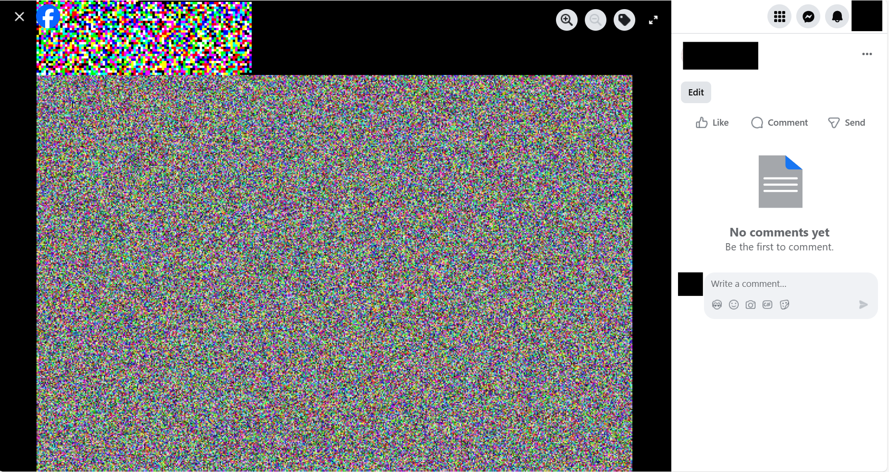

Building Blocks for aIE
← IE.Enc($\text{k}$, )
Correcntess and Secrecy
Image Encryption
(IE)
← IE.Enc($\text{k}$, Compr( ))
tag ← IMAC.Sign($\text{k}$, )
Correcntess and Unforgeability
Image MAC
(IMAC)
aIE
0/1 ← IMAC.Verify($\text{k}$, , tag )
← Embed( , tag)
Embedding
( Compr( ) , tag) ← Extract( Compr( ))
Notes:
Finally, embedding has two functionalities embed and extract. Embed combines ciphertext image and tag into a new ciphertext image. Later, extract is invokved on compressed “tagged ciphertext”, it will split it into the exact tag, and compressed ciphertext image. It allows us to transfer a small amount of bits loselessly, as part of the image., and is useful when we want to transfer IMAC tags loselessly.

Slide 21













General Construction for aIE
Encryption
Decryption
$$k_{IMAC}$$
$$k_{1}$$
Extract
IMAC.Sign
IE.Enc
$$k_{1}$$
$$k_{2}$$
$$c_{t}$$
$$k_{2}$$
$$t$$
IE.Dec
SE.Dec
SE.Enc
$$k_{IMAC}$$
$$c_{t}$$
$$t$$
Embed
IMAC.Verify
$$1$$
$$0$$
$$⊥$$
Notes:
Now we give a generic construction for aIE, leaving out details that are not important. aIE first run IMAC to generate tag for image p, then encrypts the image using IE and tag using standard symmetric encryption SE. Finally, it embeds the image ciphertext with tag ciphertext. The decryption algorithm first extracts image ciphertext and tag ciphertext, then decrypts image using IE.Dec and decrypts tag using SE. Then, it runs IMAC.Verify on the decrypted image and tag.

Slide 22




General Construction for aIE
$$k_{E}$$
$$k_{IMAC}$$
$$k_{E}$$
$$k_{IMAC}$$
Encryption
Decryption
$r←$ $
$k_{1}←$ PRF($k_{E},r$)
$k_{2}←$ PRF($k_{E},\overline{r}$)
$$k_{IMAC}$$
$$k_{1}$$
Extract
IMAC.Sign
IE.Enc
$$k_{1}$$
$$k_{2}$$
$$c_{t}$$
$$k_{2}$$
$$t$$
r
IE.Dec
SE.Dec
SE.Enc
$$k_{IMAC}$$
r
$$t$$
$$c_{t}$$
Embed
IMAC.Verify
$$1$$
$$0$$
$$⊥$$
Notes:
K1 and k2 are ephemeral keys generated from prf using root key rk on fresh sampled randomness r and complement of r.

Slide 23
General Construction for aIE
≈
We proved: for any similarity function
For the Embedding function we use, correctness of IE and IMAC implies correctness of aIE
Secrecy of IE and SE implies secrecy of aIE
Unforgeability of IMAC implies integrity of aIE
Notes:
We proved these statements in our paper.

Slide 24
General Construction for aIE
≈
We proved: for any similarity function
For the Embedding function we use, correctness of IE and IMAC implies correctness of aIE
Secrecy of IE and SE implies secrecy of aIE
Unforgeability of IMAC implies integrity of aIE
Now, how do we instantiate it?
Notes:
The question is now, how do we build such scheme for jpeg?

Slide 25
Building Blocks for aIE
← IE.Enc($\text{k}$, )
Correcntess and Secrecy
Image Encryption
(IE)
← IE.Enc($\text{k}$, Compr( ))
Image MAC
(IMAC)
aIE
Embedding
Notes:
We have the gneretic construction, but the real challenge is ot instantiate for JPEG. First, let’s talk about IE.

Slide 26
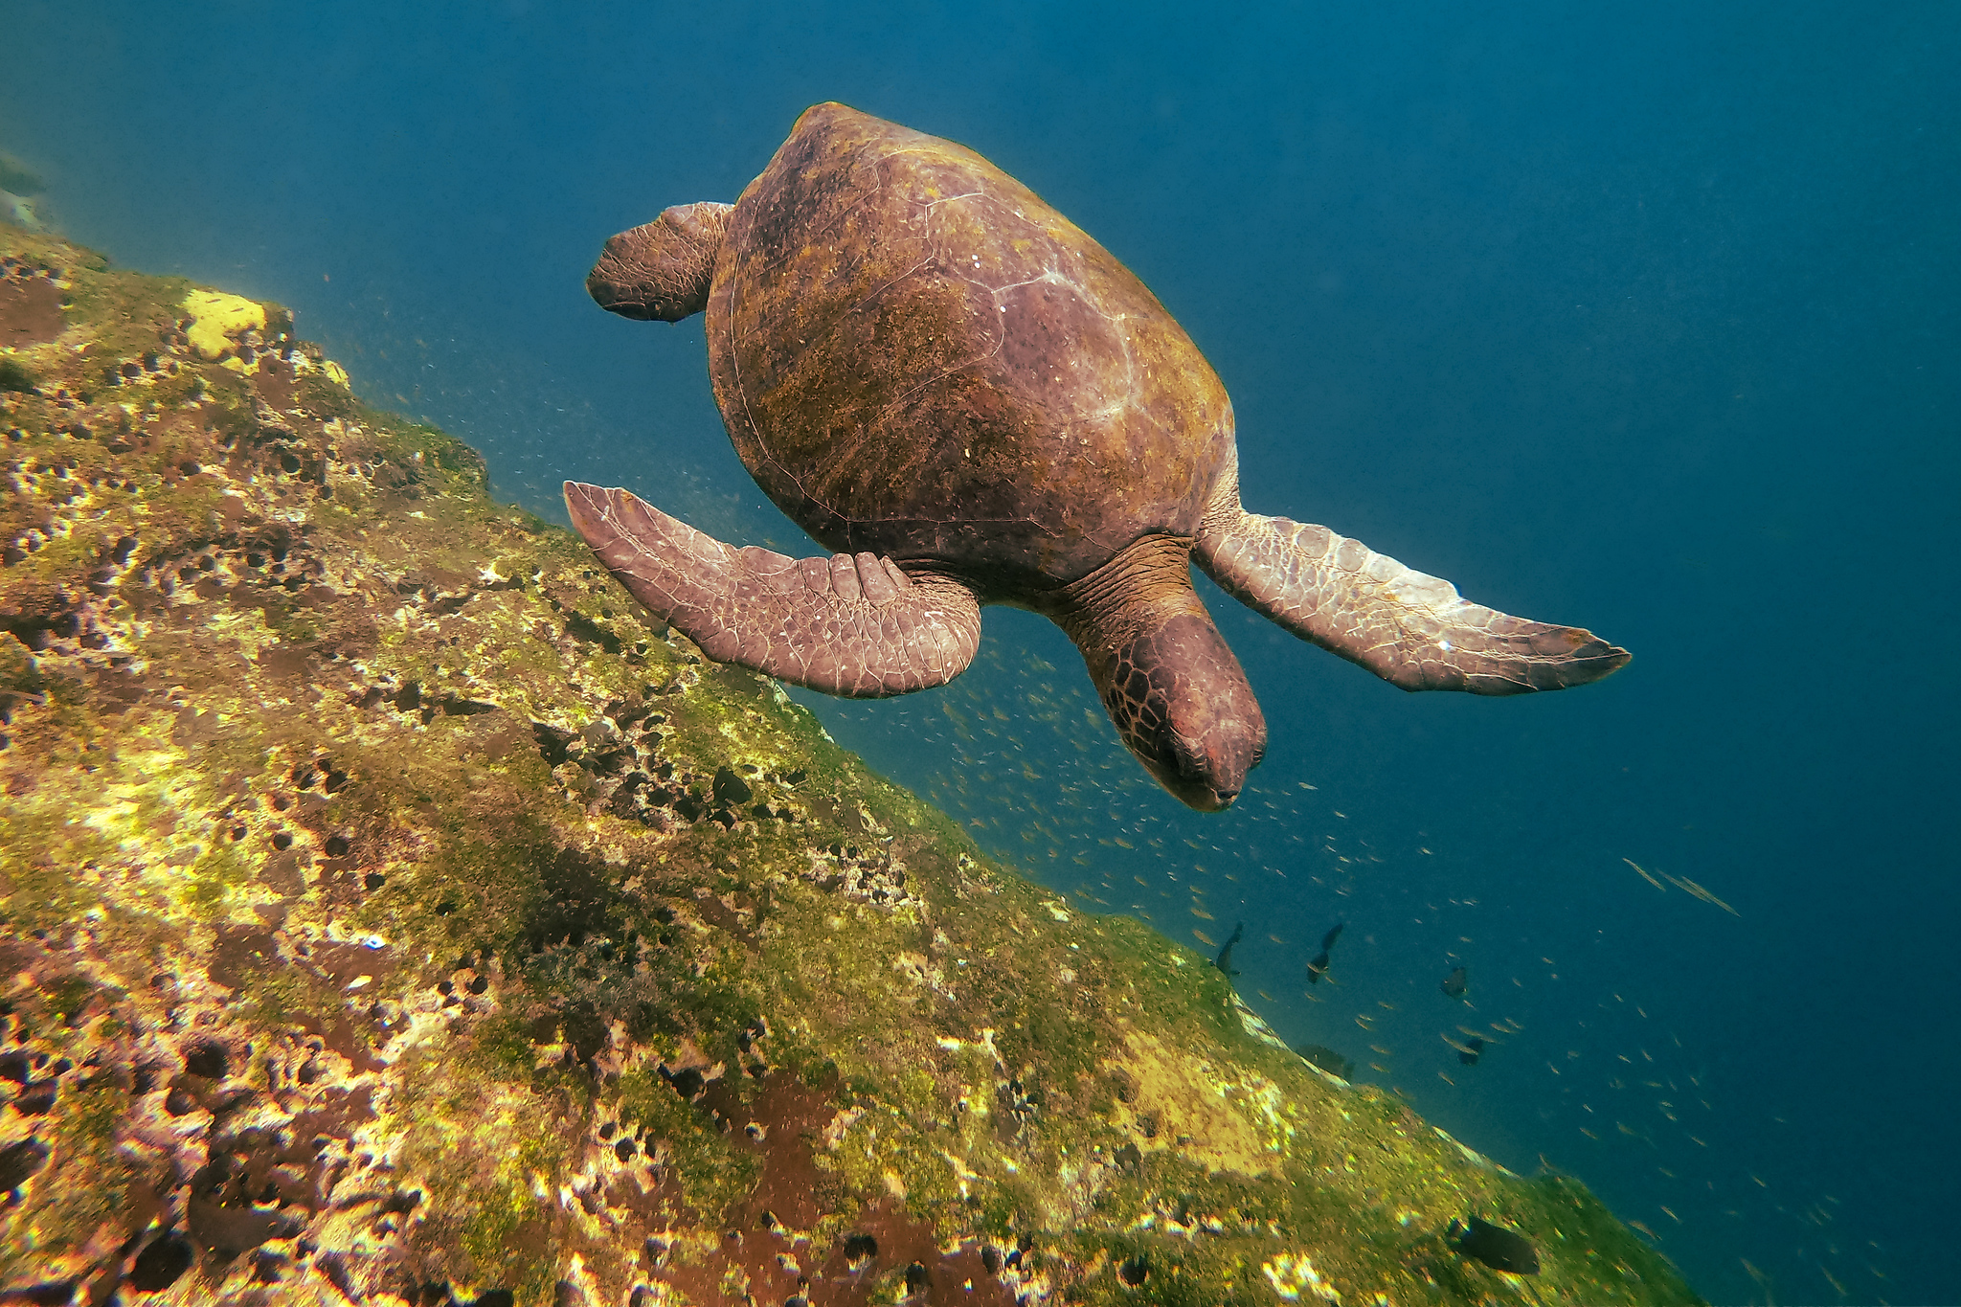
Background - Images
Images are grids of pixels, each pixel has three values ranging from 0 to 255 (in YCbcr format).
82, 158, 83 | 84, 159, 80 | 81, 158, 82
84, 154, 86 | 142, 106, 155 | 80, 153, 88
110, 104, 159 | 124, 110, 157 | 142, 100, 155
……
……

Slide 27
Background - JPEG Compression
Divides image into 8x8 blocks of pixels
For each block: divides into three layers Y, Cb, Cr
Notes:
JPEG is the most widly adopted standard for compressing images. It first divides the whole image into 8x8 pixel blocks, then decomposes it to three layers Y, Cb, and Cr.

Slide 28
Background - JPEG Compression
Divides image into 8x8 blocks of pixels
For each block: divides into three layers Y, Cb, Cr
  For Cb Cr layer: Subsample (dropping half of all pixels)
……
……
8
8
……
……
8
4
Notes:
For Cb Cr layer, JPEG performs subsampling, which essentially drops half of all pixels. So a 8x8 pixel block becomes 8x4 block. Later in decompression, the algorithm infers vales of dropped pixels from retaining pixels.

Slide 29
Background - JPEG Compression
Divides image into 8x8 blocks of pixels
For each block: divides into three layers Y, Cb, Cr
  For Cb Cr layer: Subsample (dropping half of all pixels)
  For all layers: Discrete Cosine Transform (DCT) Quantization (interger division)
Notes:
For all layers, the algorithm further performs integer division, and drop the remainders. Subsampling and quantization are two major sources of loss during compression.

Slide 30

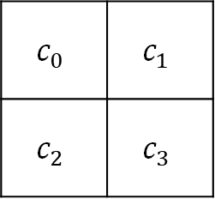
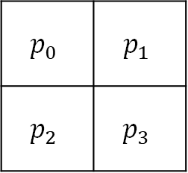
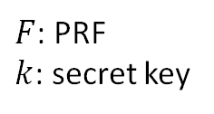
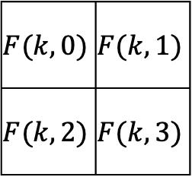
Instantiation of IE – Stream Cipher
$$p_{0}$$ | $$p_{1}$$
$$p_{2}$$ | $$p_{3}$$
$$F(k,0)$$ | $$F(k,1)$$
$$F(k,2)$$ | $$F(k,3)$$
$$c_{0}$$ | $$c_{1}$$
$$c_{2}$$ | $$c_{3}$$
mod 256
Plaintext
(integers)
$F$: PRF
$k$: secret key
Ciphertext
Notes:
We start with a very simple idea of using a stream cipher that is applied pixel-to-pixel. P are integers. Here, we iteratively apply PRF with secret key k to index of each pixel. The ciphertext is the sum of original pixel value and corresponding prf output mod 256.

Slide 31
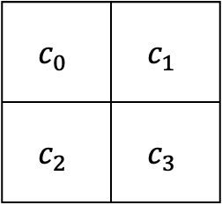
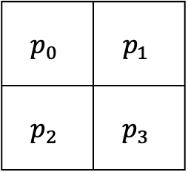
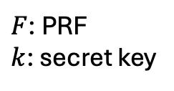
Image Encryption (IE) – Stream Cipher
$$p_{0}$$ | $$p_{1}$$
$$p_{2}$$ | $$p_{3}$$
$$F(k,0)$$ | $$F(k,1)$$
$$F(k,2)$$ | $$F(k,3)$$
$$c_{0}$$ | $$c_{1}$$
$$c_{2}$$ | $$c_{3}$$
mod 256
Plaintext
$F$: PRF
$k$: secret key
Ciphertext
Security is trivial, but correctness is tricky to achieve.
Notes:
And this is what the ciphertext look like. For IE, security is trivial, but correctness is tricky to achieve.

Slide 32

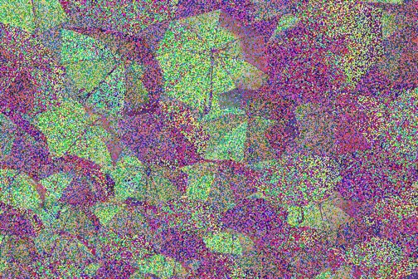
Bit-flipping Noise
Original Image
Decrypted Image
Notes:
However, if we use this algorithm as is, the decryption result is quite bad

Slide 33
Bit-flipping Noise
Original Image
Decrypted Image
Notes:
If we zoom in to a smaller part, we find many cases of colors being “flipped”, green to yellow, blue to purple. We call this “bit-flipping” noise. It is primarily the effect of quantization.

Slide 34
Bit-flipping Noise
Original Image
Decrypted Image
  For all layers: Discrete Cosine Transform (DCT) Quantization (interger division)
Notes:
If we zoom in to a smaller part, we find many cases of colors being “flipped”, green to yellow, blue to purple. We call this “bit-flipping” noise. It is primarily the effect of quantization.

Slide 35
Bit-flipping Noise – Example
Plaintext pixel value: 30
Key value: 200
Ciphertext: 200+30 = 230
Ciphertext value compressed to 190
Decrypted plaintext: 190-200 = 246 mod 256
Notes:
After examining what exactly happens at the pixel value, we find out that

Slide 36
Bit-flipping Noise – Example
Plaintext pixel value: 30
Key value: 200
Ciphertext: 200+30 = 230
Ciphertext value compressed to 190
Decrypted plaintext: 190-200 = 246 mod 256
A small change in ciphertext value can result in a huge change in plaintext value!
Notes:
Pixels close to 0 or 255 are easily to be flipped to the other end because of mod.

Slide 37
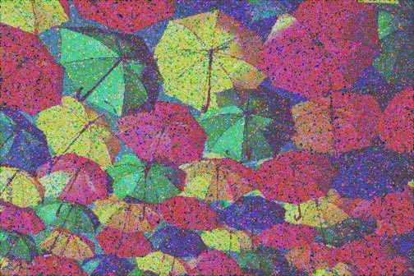
Pre/Postprocessing
We compress the plaintext ourselves to combat lossy compression.
  pushing pixel values away from both ends for quantization
0
rl
rr
255
Decryption result after the “pushing”
Notes:
Therefore, we manually pushj pixel values away from both ends in preprocessing.

Slide 38
Recall two Sources of loss…
Divides image into 8x8 blocks of pixels
For each block: divides into three layers Y, Cb, Cr
  For Cb Cr layer: Subsample (dropping half of all pixels)
  For all layers: Discrete Cosine Transform (DCT) Quantization (interger division)
✓
Notes:
Let’s see what we can do to combat subsampling.

Slide 39
Pre/Postprocessing
We compress the plaintext/ciphertext ourselves to combat lossy compression.
  pushing pixel values in plaintext away from both ends for quantization (preprocessing)
  Subsampling ciphertext ourselves by copying pixels values (postprocessing)

Slide 40
Pre/Postprocessing
We compress the plaintext/ciphertext ourselves to combat lossy compression.
  pushing pixel values in plaintext away from both ends for quantization (preprocessing)
  Subsampling ciphertext ourselves by copying pixels values (postprocessing)
We only keep half of the pixels, just like a usual compression without encryption!

Slide 41
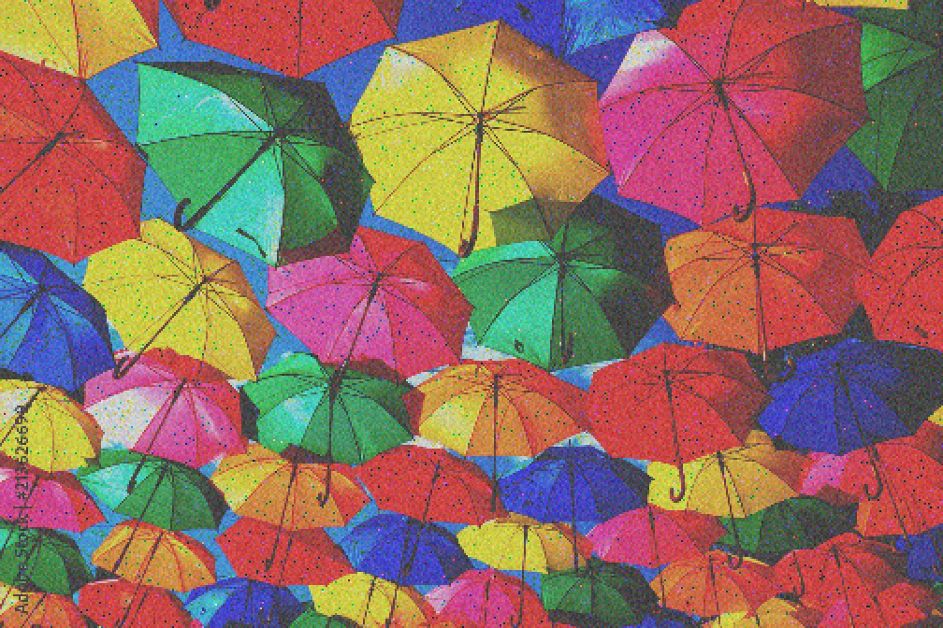
Pre/Postprocessing
We compress the plaintext/ciphertext ourselves to combat lossy compression.
  pushing pixel values in plaintext away from both ends for quantization (preprocessing)
  Subsampling ciphertext ourselves by copying pixels values (postprocessing)
Decryption result after the pre- and post-processing
Notes:
This is the result after we subsample ourselves.

Slide 42
Pre/Postprocessing
We compress the plaintext/ciphertext ourselves to combat lossy compression.
  pushing pixel values in plaintext away from both ends for quantization (preprocessing)
  Subsampling ciphertext ourselves by copying pixels values (postprocessing)
Apply a graphic filter on decrypted plaintext and expand it to original size
Notes:
Recall that during preprocessing, we have subsampled the image ourselves by choosing to keep only part of the image. Here we needs to compensate for that and expands plaintext to its original size by using a filter.

Slide 43

Pre/Postprocessing
We compress the plaintext/ciphertext ourselves to combat lossy compression.
  pushing pixel values in plaintext away from both ends for quantization (preprocessing)
  Subsampling ciphertext ourselves by copying pixels values (postprocessing)
Apply a graphic filter on decrypted plaintext and expand it to original size
Notes:
Recall that during preprocessing, we have subsampled the image ourselves by choosing to keep only part of the image. Here we needs to compensate for that and expands plaintext to its original size by using a filter.

Slide 44
Decryption after “pushing”
and “subsampling”
Original
Decryption after “pushing”,
“subsampling” and filtering
Decryption
Decryption after “pushing”

Slide 45


Building Blocks for aIE
Image Encryption
(IE)
tag ← IMAC.Sign($\text{k}$, )
Correcntess and Unforgeability
Image MAC
(IMAC)
aIE
0/1 ← IMAC.Verify($\text{k}$, , tag )
Embedding
Notes:
That is all for image encryption, next let’s talk about IMAC instantiation.

Slide 46
Image Unforgeability
tag ← IMAC.Sign($\text{k}$, )
0/1 ← IMAC.Verify($\text{k}$, , tag )
≈
Image Unforgeability:
No adversary can forge tag for images that
Notes:
Adversary cannot forge tags for a new, different image.

Slide 47
Background – Feature Extractor
Feature
Extractor
Feature Vector
Notes:
First part of IMAC contains invocation of a neural network, which outputs a feature vector for an image.

Slide 48


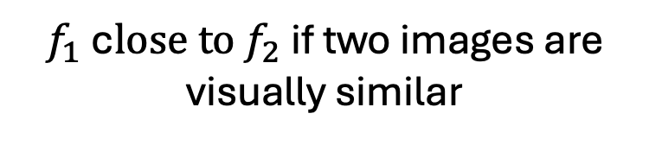


Background – Feature Extractor
$f_{1}$c$lose to f_{2}$ if two images are visually similar
Feature
Extractor
Feature
Extractor
$[x_{1}$, $x_{2}$, … ]
$[y_{1}$, $y_{2}$, … ]
$$f_{1}$$
$$f_{2}$$
Notes:
Now, if I run the same neural network on another similar images, output feature vectors should be similar.

Slide 49


Instantiation of IMAC
Feature
Extractor
$$f$$
MAC.Sign
t
$$k$$
Notes:
The signing algorithm of IMAC generates feature f of image p using neural network, and signs the feature vector using a usual MAC algorithm.

Slide 50



Instantiation of IMAC
$$f′$$
$$k$$
Feature
Extractor
MAC.Verify
1
0
$$f$$
Accept if $f$and $f′$ are close
Reject
Notes:
For verification, it first checks the validity of mac, then runs neural network to get feature vector f’ from p, and compare if f and f’ are close enough.

Slide 51
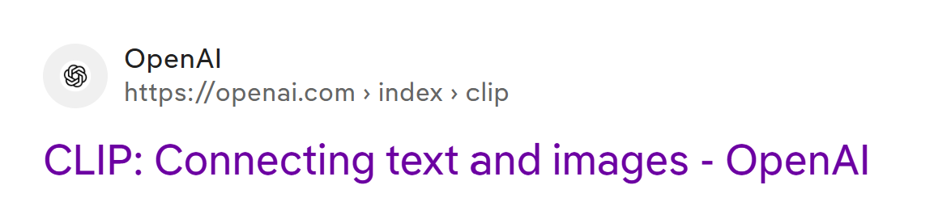

Instantiation of IMAC
Feature
Extractor
$f=(v_{0}$, $v_{1}, …,v_{255})$
Notes:
Here, we use state of the art CLIP model from openai as our neural network. The output feature vector is 256 floats.

Slide 52
How Good is CLIP when used in Our IMAC?
For correctness, we want decrypted images and original images have similar feature vectors
For security, we want images that are not visually similar have distinct feature vectors

Slide 53
How Good is CLIP when used in Our IMAC?
For correctness, we want decrypted images and original images have similar feature vectors
For security, we want images that are not visually similar have distinct feature vectors
But.. Formally what are “similar” or “distinct” feature vectors?

Slide 54


How Good is CLIP when used in Our IMAC?
For correctness, we want decrypted images and original images have similar feature vectors
For security, we want images that are not visually similar have distinct feature vectors
$[x_{1}$, $x_{2}$, … ]
similarity
score
$[y_{1}$, $y_{2}$, … ]

Slide 55
How Good is CLIP when used in Our IMAC?
For correctness, we want decrypted images and original images have similar feature vectors
For security, we want images that are not visually similar have distinct feature vectors
1
$[x_{1}$, $x_{2}$, … ]
Similar
bar
similarity
score
Not Similar
0
$[y_{1}$, $y_{2}$, … ]

Slide 56
How Good is CLIP when used in Our IMAC?
For correctness, we want decrypted images and original images have similar feature vectors
For security, we want images that are not visually similar have distinct feature vectors
There is a tradeoff between correctness and security when choosing similarity function (the “bar”)!
We choose a specific bar such that our IMAC instantiation can only achieve 97% correctness for reasonable security.

Slide 57
Building Blocks for aIE
Image Encryption
(IE)
Image MAC
(IMAC)
aIE
← Embed( , tag)
Embedding
( Compr( ) , tag) ← Extract( Compr( ))
Notes:
Finally, embedding has two functionalities embed and extract. Embed combines ciphertext image and tag into a new ciphertext image. Later, extract is invokved on compressed version of this “tagged ciphertext”, it will split it into the exact tag, and compressed image. It allows us to transfer a small amount of bits loselessly, as part of the image., and is useful when we want to transfer IMAC tags loselessly.

Slide 58
Loseless Embedding - Embed
Map bit 1 to pixel value 255, and bit 0 to pixel value 0

Slide 59
Loseless Embedding - Embed
Map bit 1 to pixel value 255, and bit 0 to pixel value 0
1
0
Compression will change pixel value to something close

Slide 60
Loseless Embedding - Embed
Map bit 1 to pixel value 255, and bit 0 to pixel value 0
Grouping pixels into an image. (Each pixel in image can have 3 pixel values)

Slide 61
Loseless Embedding - Embed
Map bit 1 to pixel value 255, and bit 0 to pixel value 0
Grouping pixels into an image. (Each pixel in image can have 3 pixel values)
Enlarge the image by 2x2

Slide 62
Loseless Embedding - Embed
Map bit 1 to pixel value 255, and bit 0 to pixel value 0
Grouping pixels into an image. (Each pixel in image can have 3 pixel values)
Enlarge the image by 2x2
a
……
Counter Subsampling
(dropping pixels)
2a
……
……
b
……
2b

Slide 63
Loseless Embedding - Embed
Map bit 1 to pixel value 255, and bit 0 to pixel value 0
Grouping pixels into an image. (Each pixel in image can have 3 pixel values)
Enlarge the image by 2x2
Loseless Embedding - Extract
Shrink the image to ¼ of its original size
Dissemble the image into list of pixel values
Map pixel value 127-255 to bit 1, and pixel value 0-126 to bit 0

Slide 64
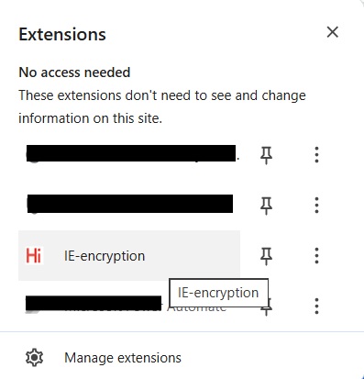
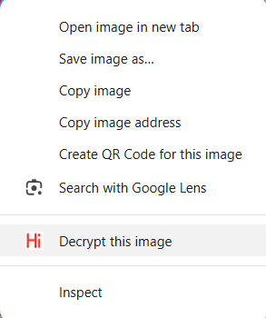
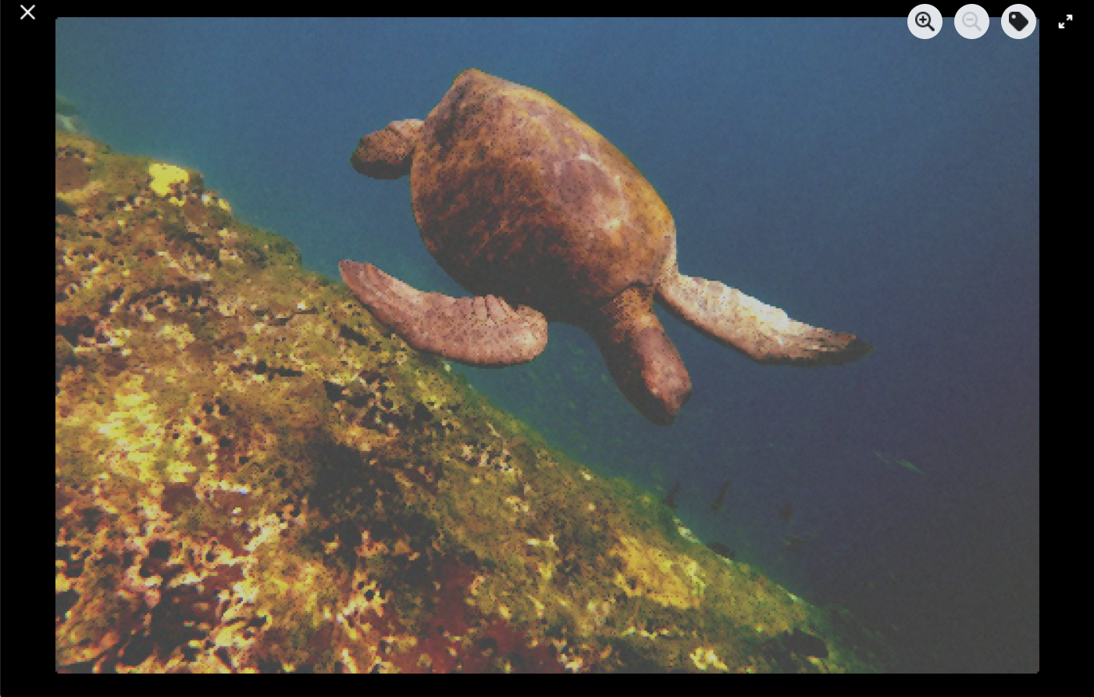
Artifact
We implemented a Chrome browser plug-in.
Notes:
Tag ciphertext is brighter than image ciphertext because tag only has pixel value 0 and 255, so it appears brighter. Well ciphertext value is random in 0-255.

Slide 65
Open Questions
Can one further improve decryption quality? Maybe use another secure encryption method?
Can one find better feature extractors and a better trade-off between security and correctness?
Notes:
Improve image quality, maybe different feature extractor, better tradeoff, perceptual hash

Slide 66

Summary:
We present a new primitive specifically for authenticated image encryption that is format-preserving and compression-tolerating.
We give a construction for the most widely used compression algorithm JPEG and prove that our construction is secure.
Our code will be available at iacr artifacts
We will upload our paper to eprint soon.

